Slide 1


APRIL 22 2025
MCCD DATA CONSULTANTS' PRESENTATION
TRANSFORMING INFORMATION INTO IMPACT

Slide 2

LEADERSHIP TEAM
“Information is the oil of the 21st century, and analytics is the combustion engine.” — Peter Sondergaard, former Senior Vice President at Gartner​
MAKOMBORERO CHIVANDIRE
PETER MANGORO
RODNEY CHIWANGA
MASHEIA DZIMBA

Slide 3

MISSION
MCCD DATA CONSULTANTS
Our mission is to harness the power of data analytics to enhance public safety and operational efficiency. We specialize in transforming complex datasets into actionable insights, enabling organizations like Fleet Safe Inc. to make informed decisions that reduce traffic violations, improve driver behavior, and foster a culture of accountability. Through strategic analysis and innovative solutions, we are committed to driving measurable improvements in transportation safety and community well-being.

Slide 4

VISION
MCCD DATA CONSULTANTS
To be a leading force in transforming transportation safety through innovative data analytics, empowering organizations to make informed decisions that enhance public safety, reduce traffic violations, and foster a culture of accountability and continuous improvement.

Slide 5

A corporate fleet management company operating in New York.
F
STAKEHOLDER
FLEETSAFE INC
Pain Points
Objectives
Insights
High traffic violations leading to increased insurance costs.
Uncertainty about the effectiveness of public awareness campaigns campaigns
Reduce traffic violations and improve driver safety.
Implement targeted training based on data insights.
Enhance compliance with traffic laws and regulations.
Identify the most common types of traffic violations.
Analyze trends in violations based on weather conditions.
Examine seasonal patterns in violations over the year.
Assess violations by gender and age group.
Determine the days of week with the highest violation counts.

Slide 6


Visualization and Insights
The key insights derived from our comprehensive analysis of traffic violation data, unveils highlighting patterns across demographics, timeframes, and environmental conditions.
Through a series of targeted visualizations—including bar charts, line graphs, and heat maps—we identify high-risk groups, peak violation periods, and geographical hotspots.
These findings inform strategic recommendations aimed at enhancing road safety and reducing infractions, aligning with FleetSafe Inc.'s commitment to data-driven decision-making.
MCCD Traffic violation project

Slide 7
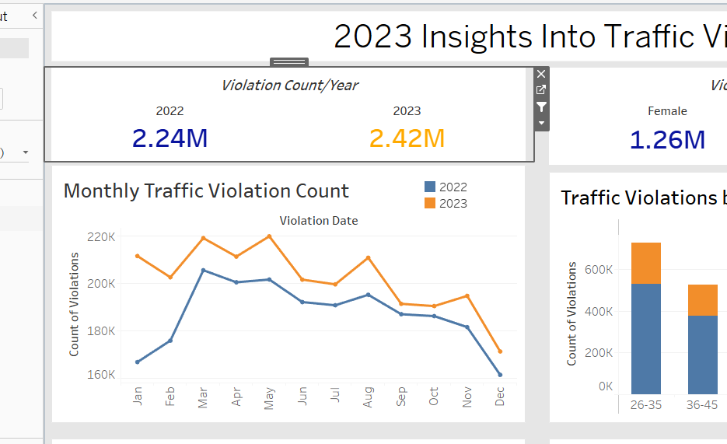
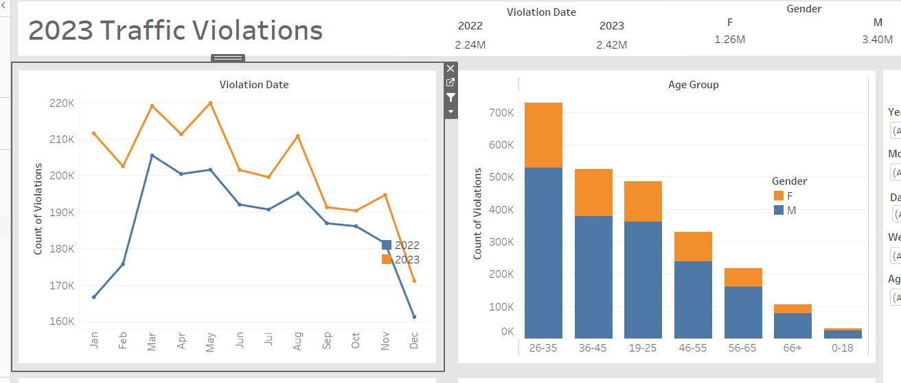
Monthly Violation Count
Visualization
The chart illustrates a significant increase in traffic violations from 2022 to 2023, highlighting a growing concern for road safety. This upward trend underscores the need for proactive measures to curb unsafe driving behaviors.
Solution
Implementing targeted traffic awareness campaigns and enhancing enforcement strategies are essential steps toward reversing this trend and promoting safer roadways.​
MCCD Traffic violation project

Slide 8
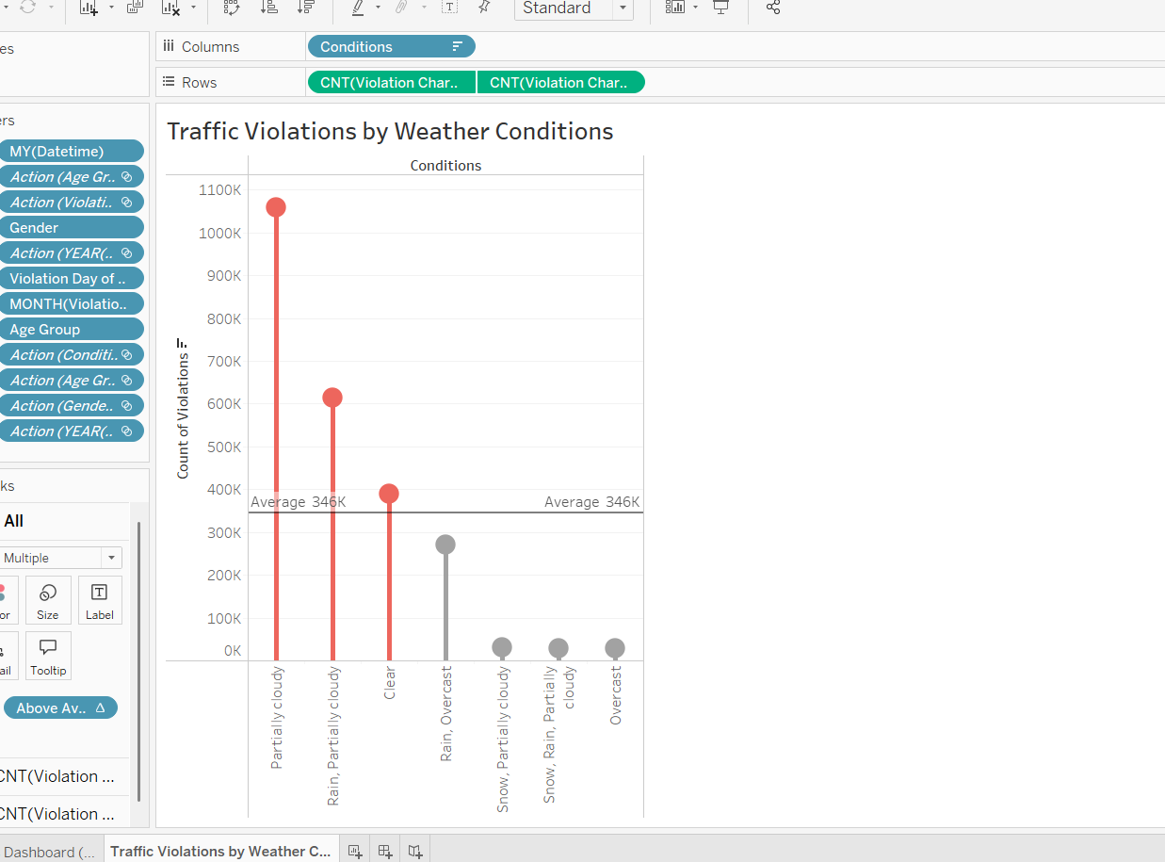
Visualization
​This visualization highlights the correlation between weather conditions and traffic violations. Notably, there is a significant increase in violations during clear and partially cloudy conditions. This trend suggests that drivers may become complacent or overconfident when weather conditions are favorable, leading to a higher incidence of traffic infractions.
Problem
The data indicates that favorable weather conditions, such as partially cloudy skies, are associated with an uptick in traffic violations. This pattern implies that drivers may underestimate risks or engage in riskier behaviors when weather conditions are perceived as safe.
Solution
To address this issue, targeted awareness campaigns should be implemented to educate drivers about the importance of maintaining safe driving practices regardless of weather conditions. Emphasizing that clear weather does not equate to risk-free driving can help mitigate the rise in violations during such conditions.
MCCD Traffic violation project

Slide 9
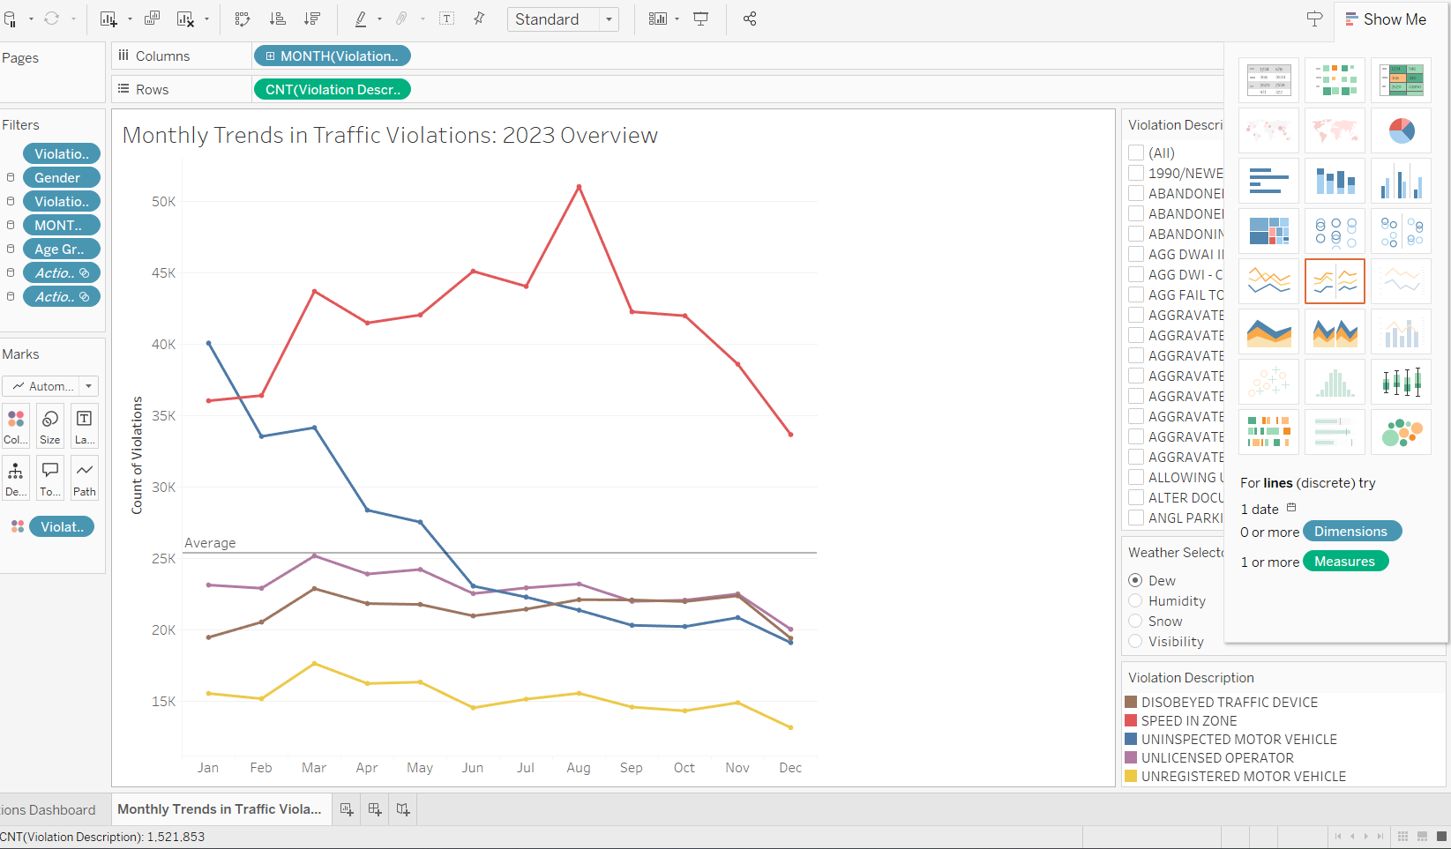
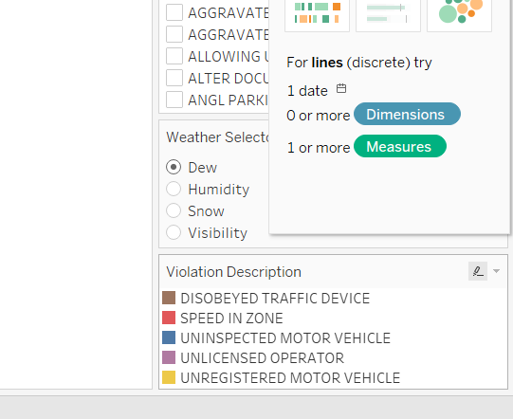
Key Insight
​This line chart visualizes monthly trends for the top five traffic violations of 2023.The chart reveals clear seasonal patterns, with certain violations spiking during specific months, offering insight into when risk is highest.
Core Issue – Seasonal Spikes
The distinct seasonal surges in violation counts indicate periods of heightened risk. For instance, speeding violations (categorized as “Speed in Zone”) jump in the summer while uninspected vehicle violations peak in the early year. These spikes suggest periodic lapses in compliance during particular seasons, driving up safety risks and costs during those times.
Solution
To address the seasonal spikes in traffic violations, a combined strategy of public awareness and targeted enforcement is essential. Educational campaigns should be launched ahead of high-risk periods—such as speeding in summer or inspection-related issues early in the year—to promote safer driving habits. Simultaneously, policy enforcement should be intensified during these peak months through increased patrols and compliance checks, ensuring that both awareness and accountability work together to reduce violations effectively
MCCD Traffic violation project

Slide 10
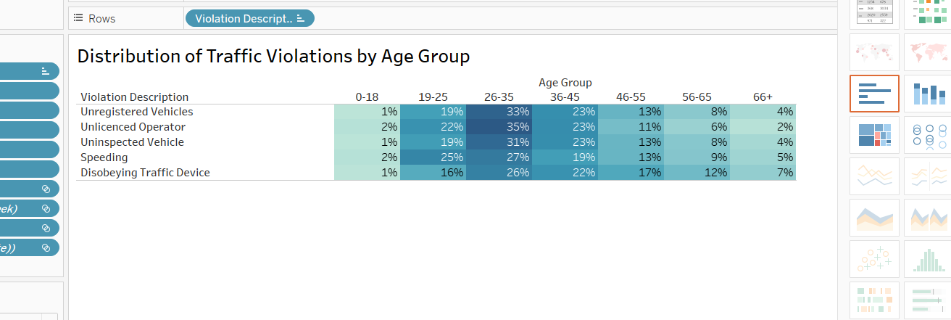
Violations Patterns by Age Group 0
Visualization
Problem
Solution
This heatmap shows the distribution of traffic violations by age group across five key violation types.
It visually emphasizes that younger drivers, especially those aged 26–35, are consistently involved in a higher percentage of all top violations—most notably in operating unlicensed and unregistered vehicles.
Fleet Safe should implement age-focused driver education programs and behavioral awareness campaigns tailored to this demographic.
Emphasizing responsibility, rule adherence, and the consequences of infractions can help reduce violations and foster safer driving habits among younger drivers
The 26–35 age group poses a significant risk on the roads, leading in nearly all categories of traffic infractions.
Without targeted intervention, these behaviors may continue to drive up violation rates and compromise safety.

Slide 11
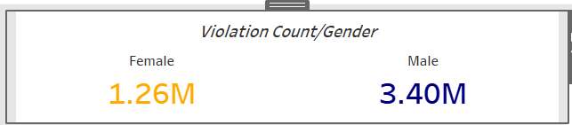
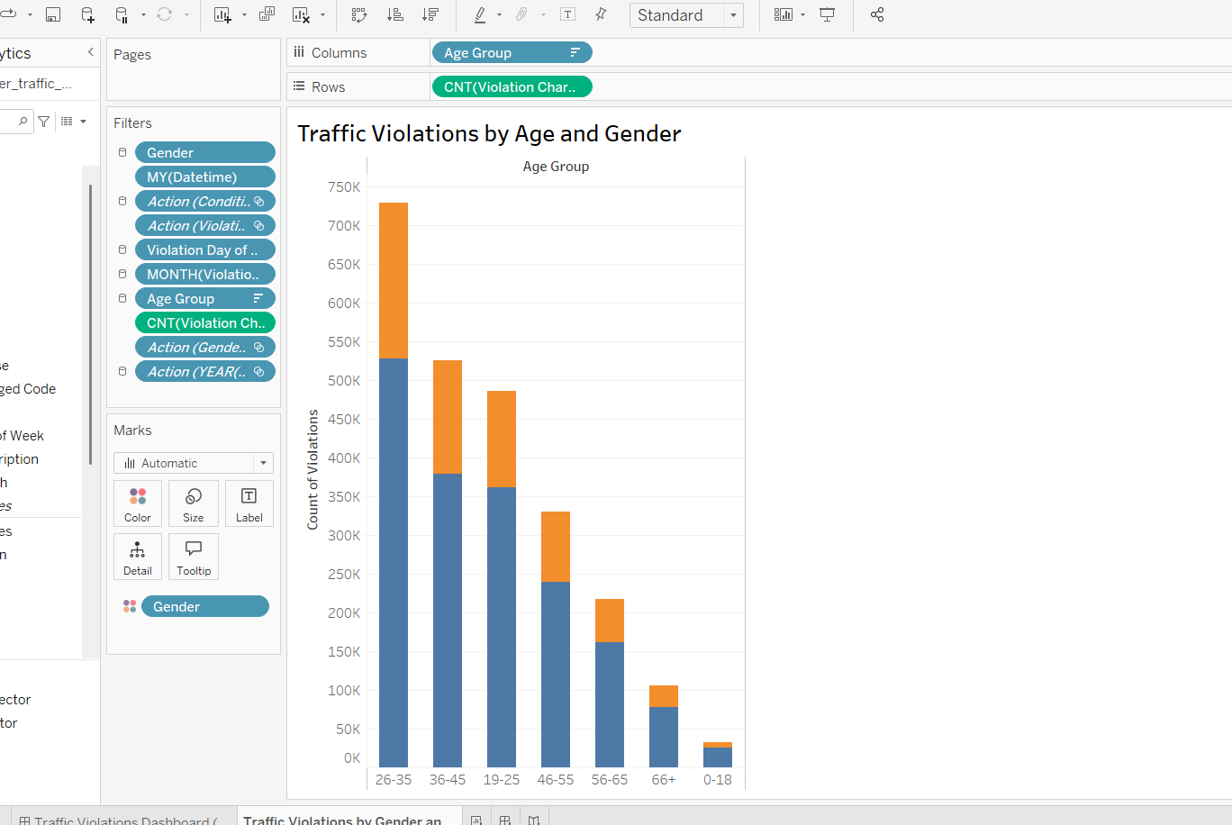
Key Insight
This stacked bar chart displays traffic violations by age group and gender, clearly showing that the 26–35 age group accounts for the highest number of offenses, with a notable contribution from both male and female drivers
Core Issue
The concentration of violations in this age segment indicates a behavioral risk that, if unaddressed, could continue to inflate incident rates and operational costs for FleetSafe Inc.
Solution
FleetSafe should implement age-specific training programs focused on safe driving practices for individuals aged 26–35. Additionally, introducing gender-responsive awareness campaigns could help tailor messaging and intervention strategies more effectively, addressing the distinct behavioral patterns observed across male and female drivers.
MCCD Traffic violation project

Slide 12
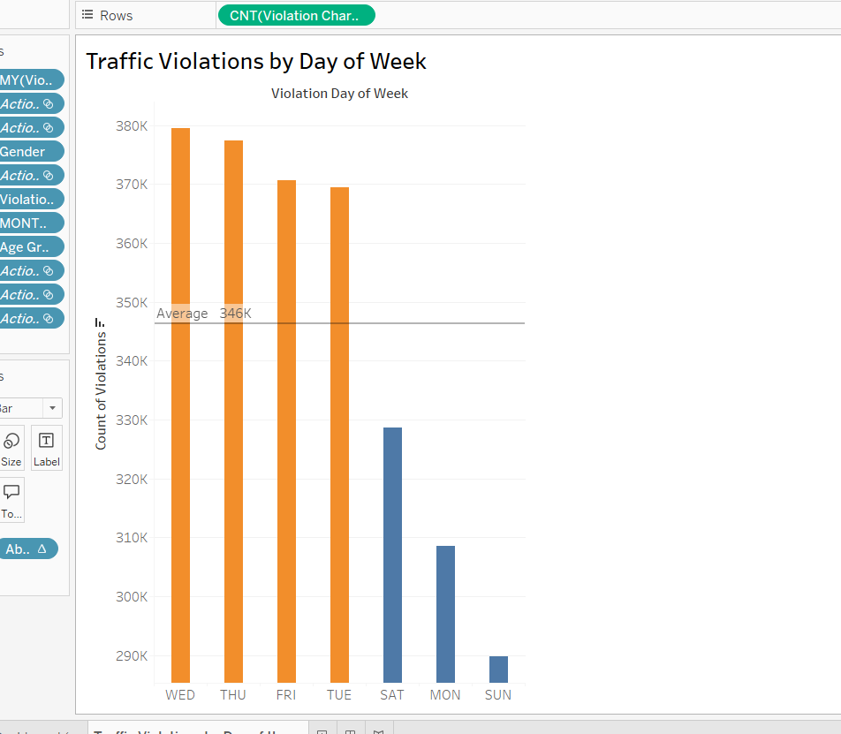
Key Insight
This bar chart displays the count of traffic violations by each day of the week, with a reference line marking the weekly average of 346K. The data shows that Wednesdays, Thursdays, and Fridays consistently record the highest violation rates—well above average.
Core Issue
The concentration of violations during midweek suggests patterns of increased traffic volume or reduced driver caution during workdays, which may contribute to a higher risk of infractions.
Solution
FleetSafe should align training sessions and safety awareness campaigns with these high-violation days to maximize impact. Additionally, reinforcing enforcement measures midweek—such as random checks or digital reminders—could help reduce risky behavior and improve compliance when violations are most frequent.
MCCD Traffic violation project

Slide 13
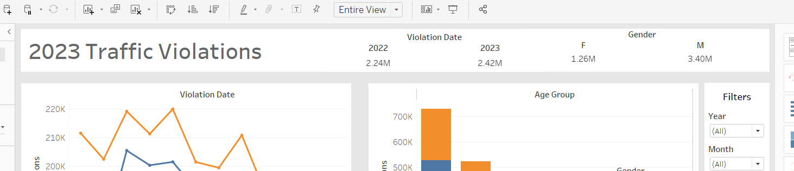
Summary of 2023 Findings
KEY METRICS/
STATISTICS
📈 Projected Impact with Intervention
📊 Top Violation Type:
Speeding in Zone – accounts for 29.6% of total violations
👥 Most Affected Age Group:
26–35 years – responsible for over 33% of key violations
Violation Reduction Target: 🚦 20% cut in total violations by next year
🗓️ Peak Violation Days:
Wednesday & Thursday – exceed weekly average by over 10%
🌤️ Weather Impact Insight:
Clear weather accounts for over 700,000 violations – highest by condition
Estimated Cost Savings: 💰 Up to $1.5 million in reduced insurance and legal risk for FleetSafe Inc.

Slide 14



THANK YOU
215 Lexington Ave Yeshiva
+12029716142
mccd@dataconsultgroup.com

